Slide 1
Let’s go out !
外に出かけましょう！！
TEAM 3 : EQUINOXES
Supatcha Maitreesophon 1AY15010
Hattaya ponghirun 1AY15017

Slide 2
background
Nowadays people would like to stay inside their house enjoy surfing internet or do activities that no need to go out of the room.
The city facilities that used to popular became less popular.
So We want to encourage people to go out and enjoy outside activities by using city facilities.

Slide 3
Objective
To give the information about facilities to people who live around Fuchinobe station
To encourage people to go out, use the facilities and communicate with other people

Slide 4
How we’ve done
Use ingress to find facilities around fuchinobe station.
Choose the city facilities that not far away from fuchinobe station
search for the things we can do at that place

Slide 5
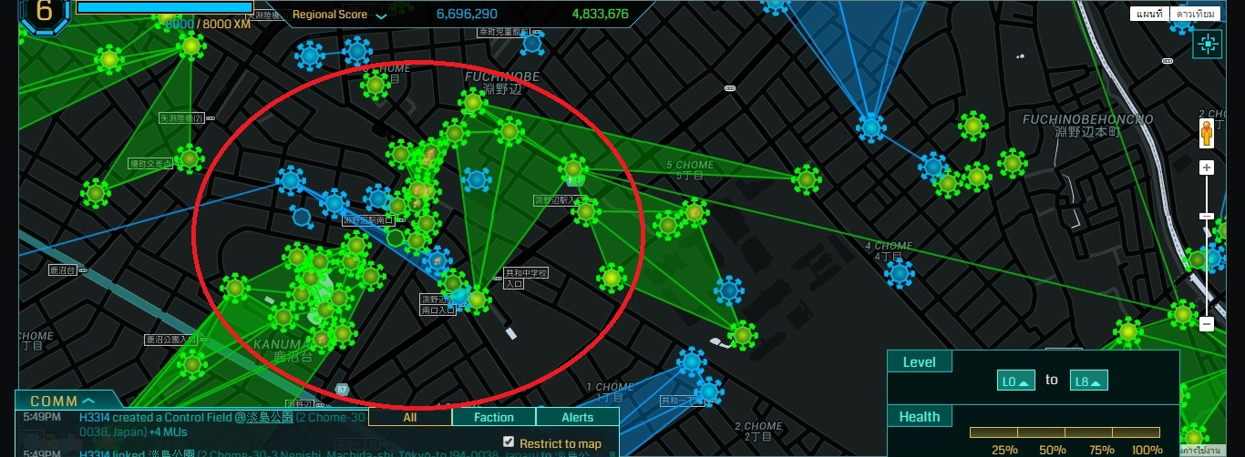

Slide 6
Route
Start at Fuchinobe station
Go to Kanuma-dai 2 chome Park
Go to Kanuma park Hack or answer question at
kanuma kouen no monument portal
kanuma kouen no suberidai portal
kanuma kouen no tako portal
Go to city library and hack
Go to last portal of the route, kyouwakita park

Slide 7
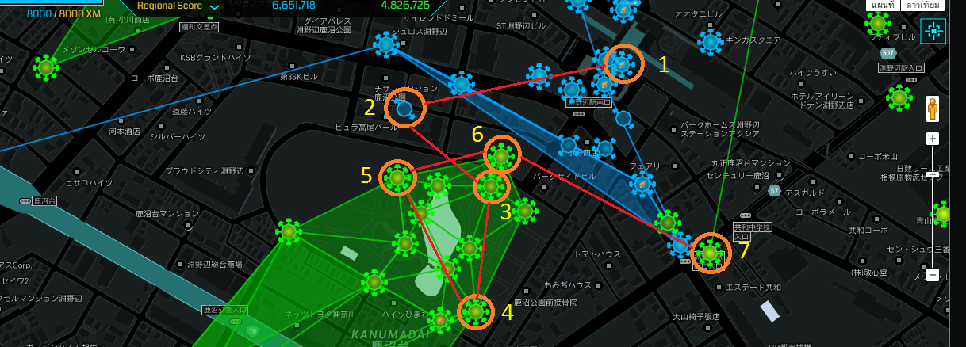

Slide 8
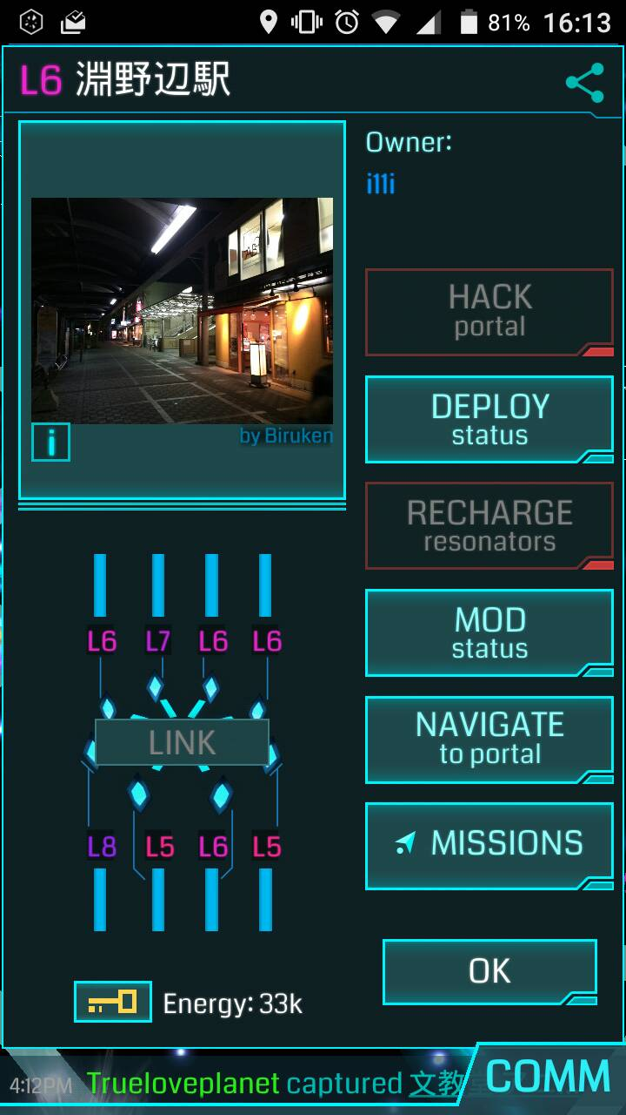
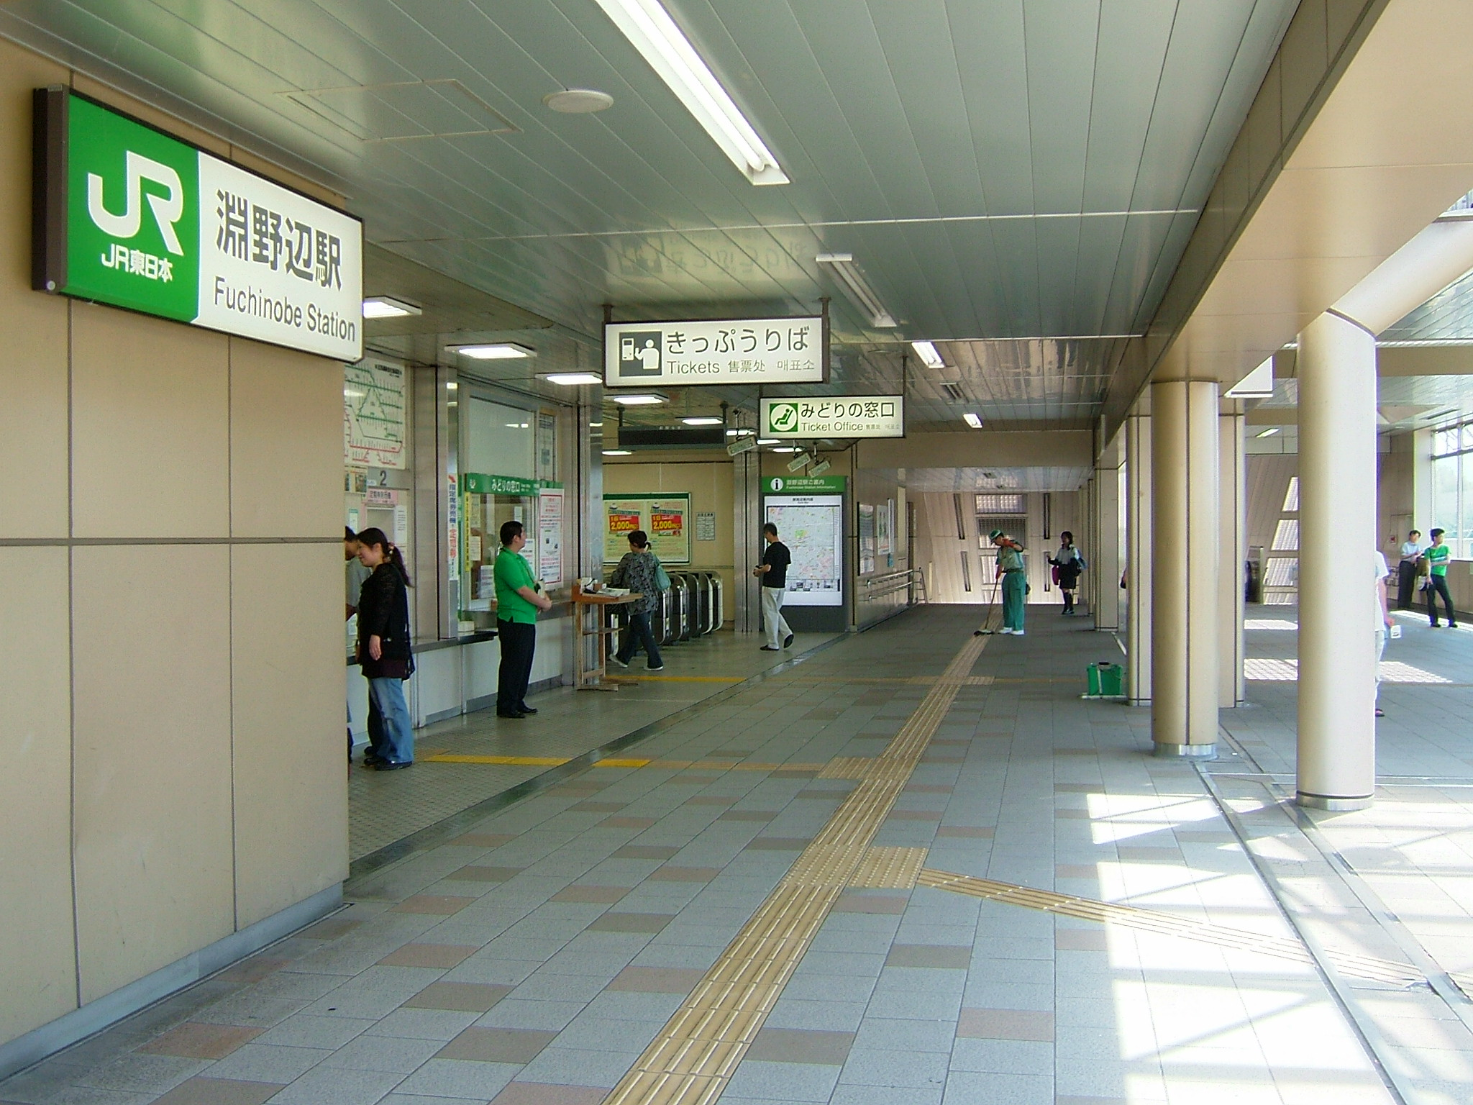
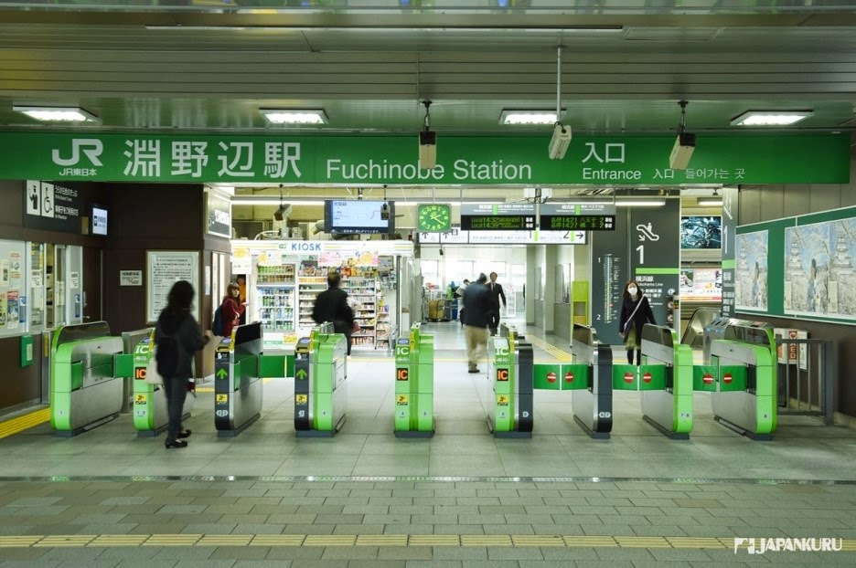

Slide 9
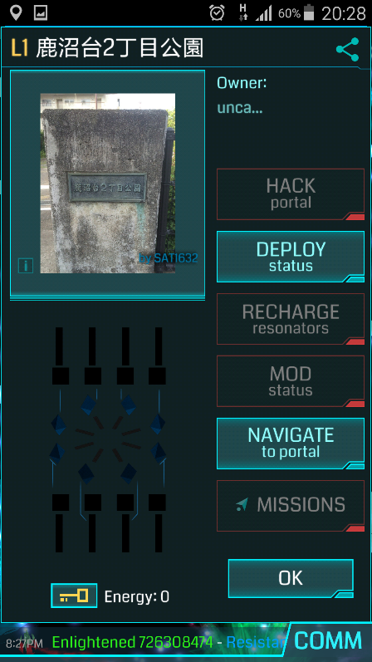
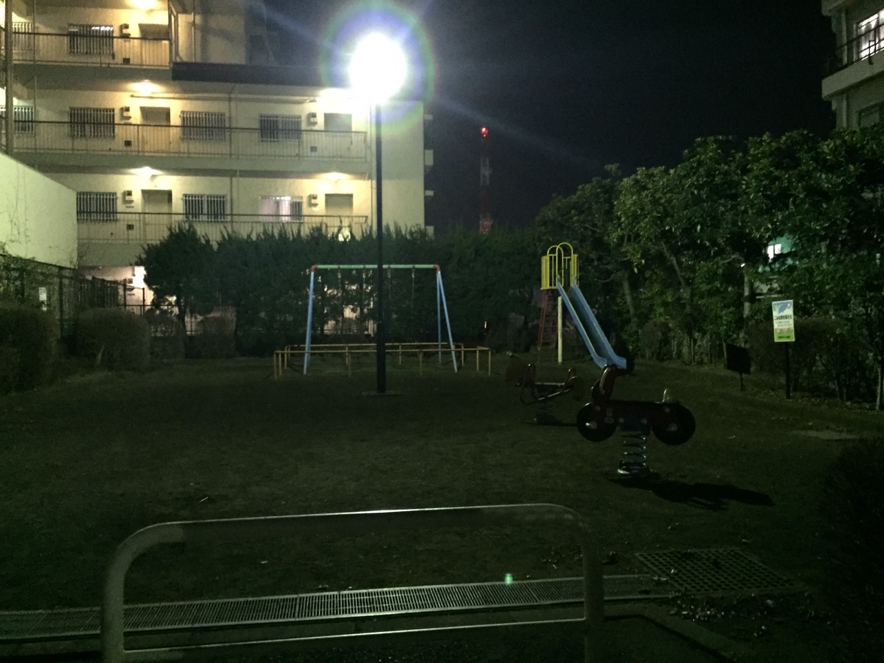

Slide 10
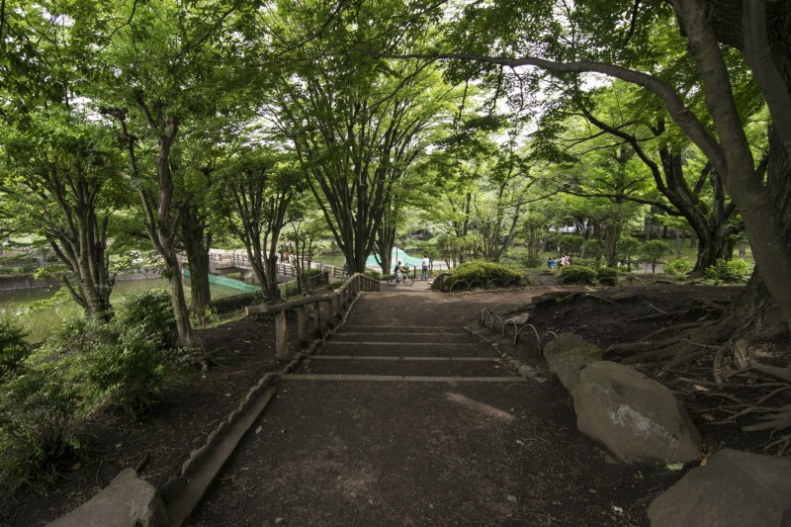
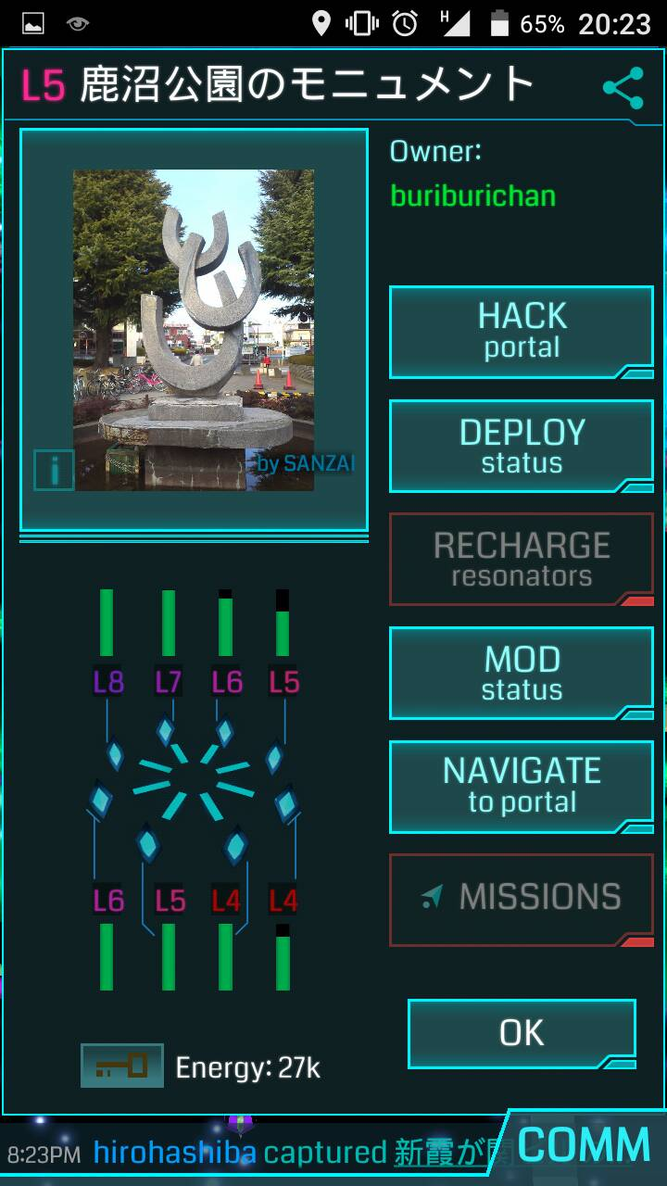
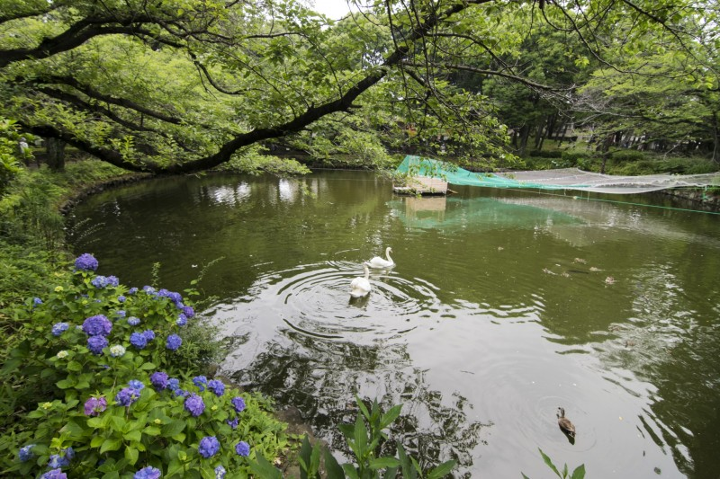

Slide 11
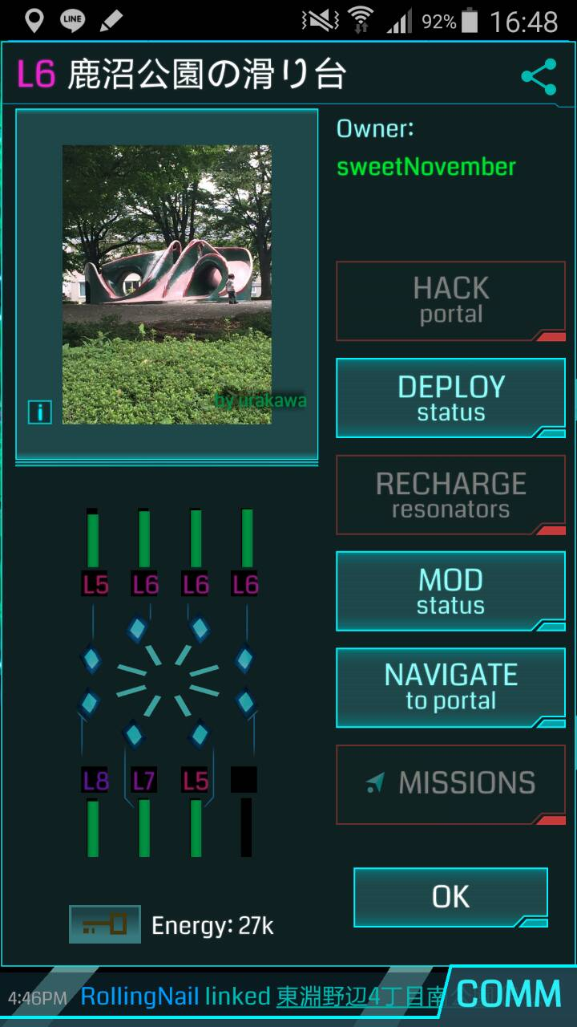
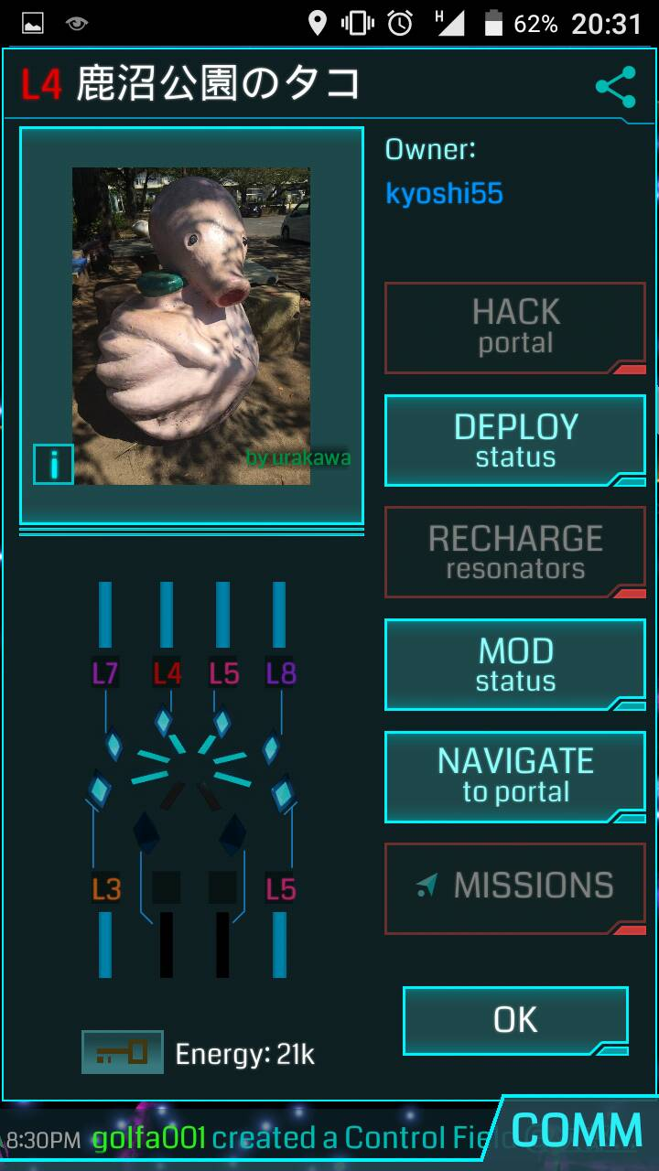

Slide 12
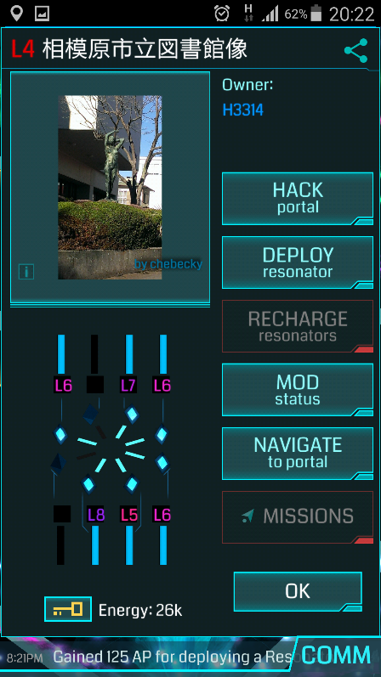
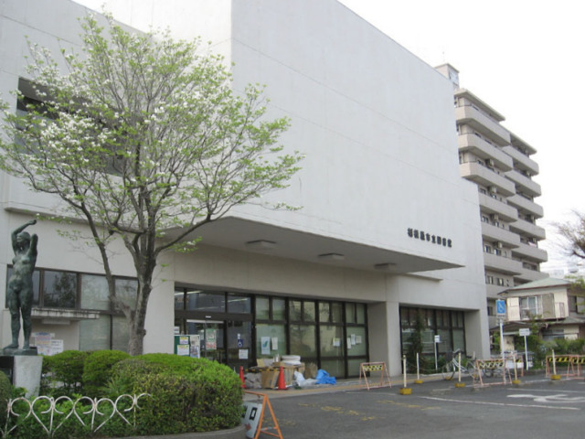
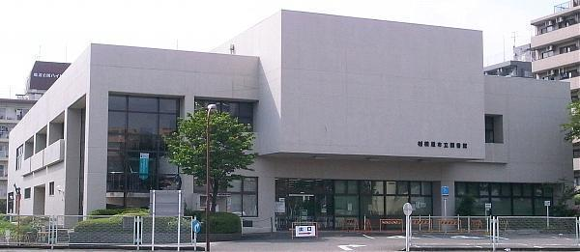

Slide 13
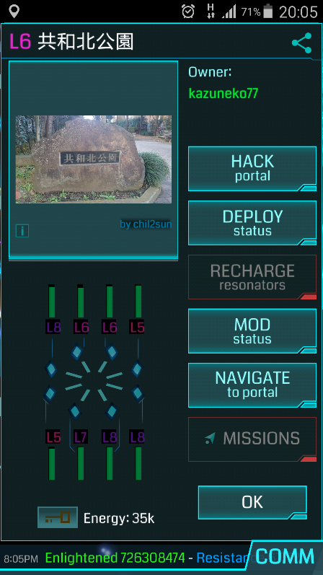
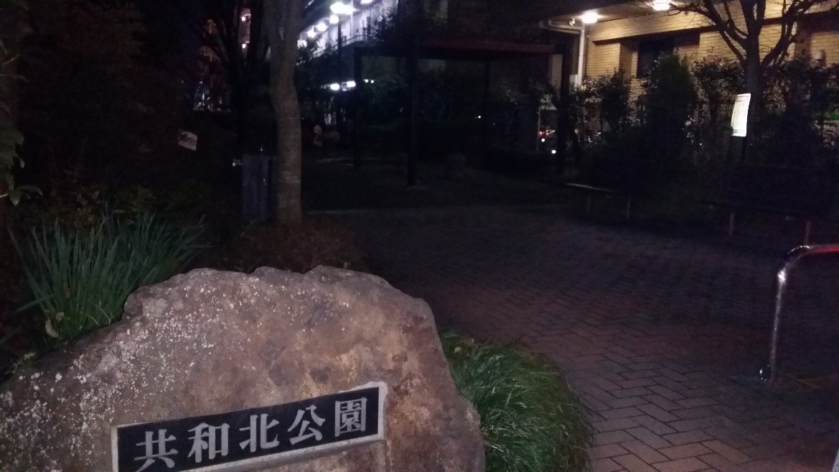
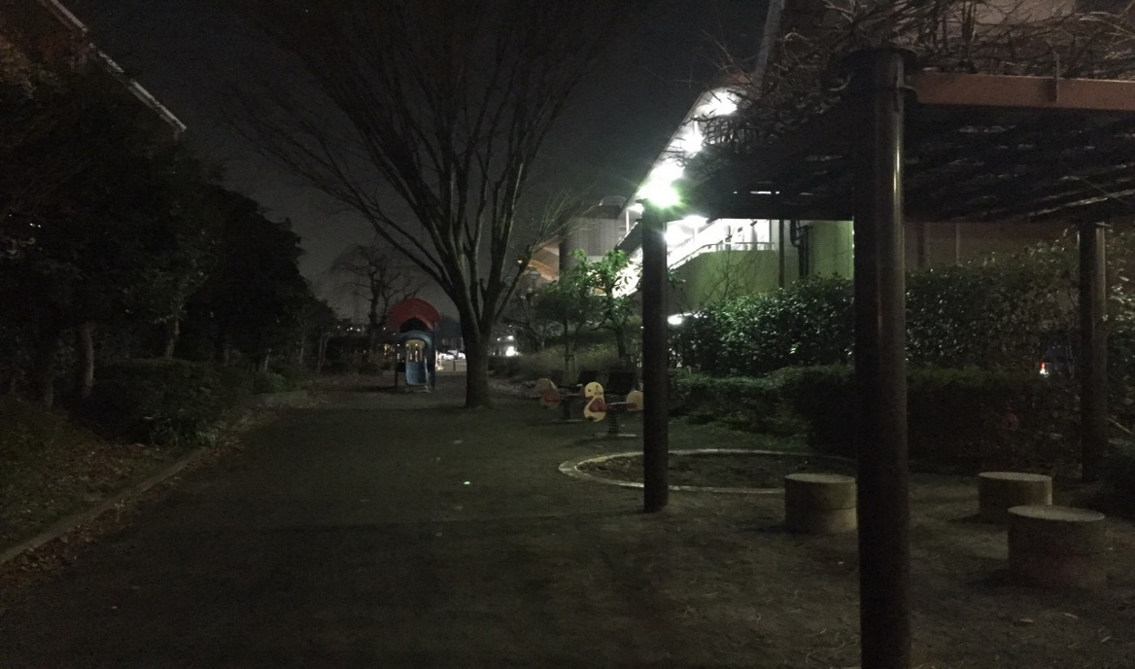

Slide 14
How to complete mission
Hack the portal at city facilities or answer the question about that place
The questions are not hard to find the answers but make you know more about that place
For example,
How much does it cost to rent the bicycle at park, etc.
When you go near the portal or interesting spot , the information about that place will pop-up.
For example,
There is the toilet
What you can do in that place? (ex. There is a picnic spot, the traffic mini-themepark at kanuma park)

Slide 15
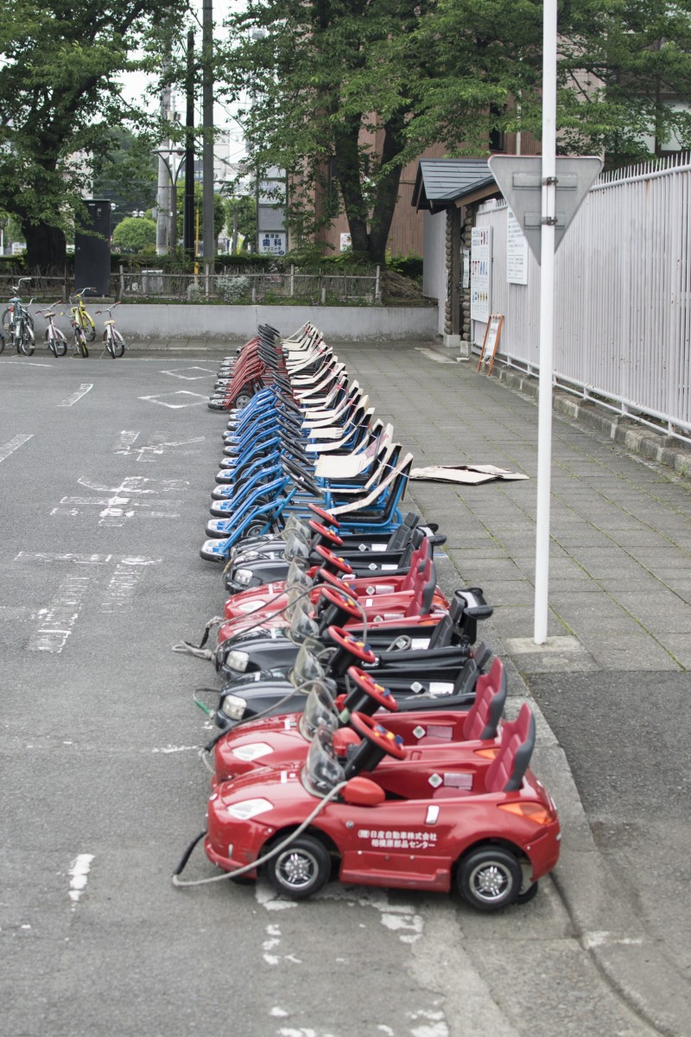
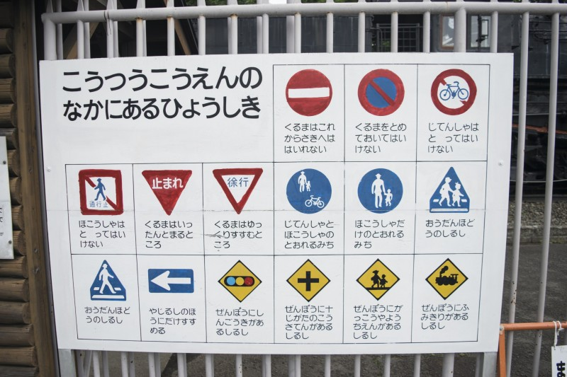
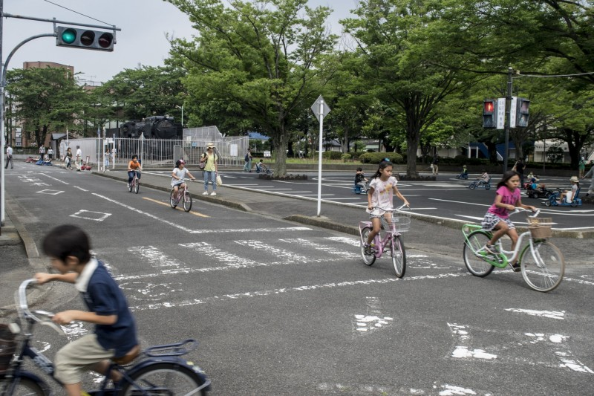
Traffic signs all around the mini-theme park and out on real roads in japan

Slide 16
Advantages
People who do this mission will……
Know the facilities location
know that what they can do in the city facilities.
For examples,
have a picnic, rent bicycle, enjoy traffic theme park , etc.
(to know the information ,you have to walk around the park)
Enjoy the beautiful environment around the town
(that’s make you want to go out more than before)

Slide 17
advantages
If people go out and use facilities, the city will be more lively and that is also good for their physical and mental health.
for examples, they can do exercising And Build up friendship between people in community to reduce their stress.
Using city facilities and talking with each other will make people feel like they are a part of the community and make the community more livable.

Slide 18
Thank you

